Slide 1
MET CS 520 – Information Structures with Java
Arrays, Lists, Sets, Maps, Iterators

Slide 2
Introduction to Arrays
An array is a data structure used to process a collection of data that is all of the same type
An array behaves like a numbered list of variables with a uniform naming mechanism
It has a part that does not change: the name of the array
It has a part that can change: an integer in square brackets
For example, given five scores:
score[0], score[1], score[2], score[3], score[4]

Slide 3
Creating and Accessing Arrays
An array that behaves like this collection of variables, all of type double, can be created using one statement as follows:
double[] score = new double[5];
Or using two statements:
double[] score;
score = new double[5];
The first statement declares the variable score to be of the array type double[]
The second statement creates an array with five numbered variables of type double and makes the variable score a name for the array

Slide 4
Creating and Accessing Arrays
The individual variables that together make up the array are called indexed variables
They can also be called subscripted variables or elements of the array
The number in square brackets is called an index or subscript
In Java, indices must be numbered starting with 0, and nothing else
score[0], score[1], score[2], score[3], score[4]

Slide 5
Creating and Accessing Arrays
The number of indexed variables in an array is called the length or size of the array
When an array is created, the length of the array is given in square brackets after the array type
The indexed variables are then numbered starting with 0, and ending with the integer that is one less than the length of the array
score[0], score[1], score[2], score[3], score[4]

Slide 6
Creating and Accessing Arrays
double[] score = new double[5];
A variable may be used in place of the integer (i.e., in place of the integer 5 above)
The value of this variable can then be read from the keyboard
This enables the size of the array to be determined when the program is run
double[] score = new double[count];
An array can have indexed variables of any type, including any class type
All of the indexed variables in a single array must be of the same type, called the base type of the array

Slide 7
Declaring and Creating an Array
An array is declared and created in almost the same way that objects are declared and created:
BaseType[] ArrayName = new BaseType[size];
The size may be given as an expression that evaluates to a nonnegative integer, for example, an int variable
char[] line = new char[80];
double[] reading = new double[count];
Person[] specimen = new Person[100];

Slide 8
Referring to Arrays and Array Elements
Each array element can be used just like any other single variable by referring to it using an indexed expression: score[0]
The array itself (i.e., the entire collection of indexed variables) can be referred to using the array name (without any square brackets): score
An array index can be computed when a program is run
It may be represented by a variable: score[index]
It may be represented by an expression that evaluates to a suitable integer: score[next + 1]

Slide 9
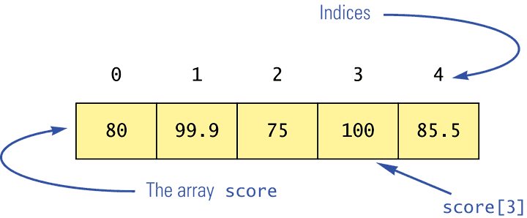
Using the score Array in a Program
The for loop is ideally suited for performing array manipulations:
for (index = 0; index < 5; index++)
System.out.println(score[index] + " differs from max by " + (max-score[index]) );

Slide 10
Three Ways to Use Square Brackets [] with an Array Name
Square brackets can be used to create a type name:
double[] score;
Square brackets can be used with an integer value as part of the special syntax Java uses to create a new array:
score = new double[5];
Square brackets can be used to name an indexed variable of an array:
max = score[0];

Slide 11
The length Instance Variable
An array is considered to be an object
Since other objects can have instance variables, so can arrays
Every array has exactly one instance variable named length
When an array is created, the instance variable length is automatically set equal to its size
The value of length cannot be changed (other than by creating an entirely new array with new)
double[] score = new double[5];
Given score above, score.length has a value of 5

Slide 12
Pitfall: Array Index Out of Bounds
Array indices always start with 0, and always end with the integer that is one less than the size of the array
The most common programming error made when using arrays is attempting to use a nonexistent array index
When an index expression evaluates to some value other than those allowed by the array declaration, the index is said to be out of bounds
An out of bounds index will cause a program to terminate with a run-time error message
Array indices get out of bounds most commonly at the first or last iteration of a loop that processes the array: Be sure to test for this!

Slide 13
Initializing Arrays
An array can be initialized when it is declared
Values for the indexed variables are enclosed in braces, and separated by commas
The array size is automatically set to the number of values in the braces
int[] age = {2, 12, 1};
Given age above, age.length has a value of 3

Slide 14
Initializing Arrays
Another way of initializing an array is by using a for loop
double[] reading = new double[100];
int index;
for (index = 0;
index < reading.length; index++)
reading[index] = 42.0;
If the elements of an array are not initialized explicitly, they will automatically be initialized to the default value for their base type

Slide 15
Arrays versus Collections
Arrays are normally used when the number of elements is known in advance. The elements are stored in the array and various operations are performed on those elements.
Arrays provide direct access to the elements stored in the data structure. However, insertion, removal, and lookup of objects in the array are not straightforward operations.
The classes in the Collection hierarchy are used when the number of elements varies during the lifetime of the application. They also provide operations for insertion, removal, and lookup of objects.

Slide 16
Collections
Lists
dynamic set of objects that can be added to or removed from. Lists can have duplicates.
Sets
dynamic set of objects that can be added to or removed from. Sets cannot have duplicates.
Maps
set of objects that are indexed by a key.
Iterators
Common mechanism for traversing collections.

Slide 17
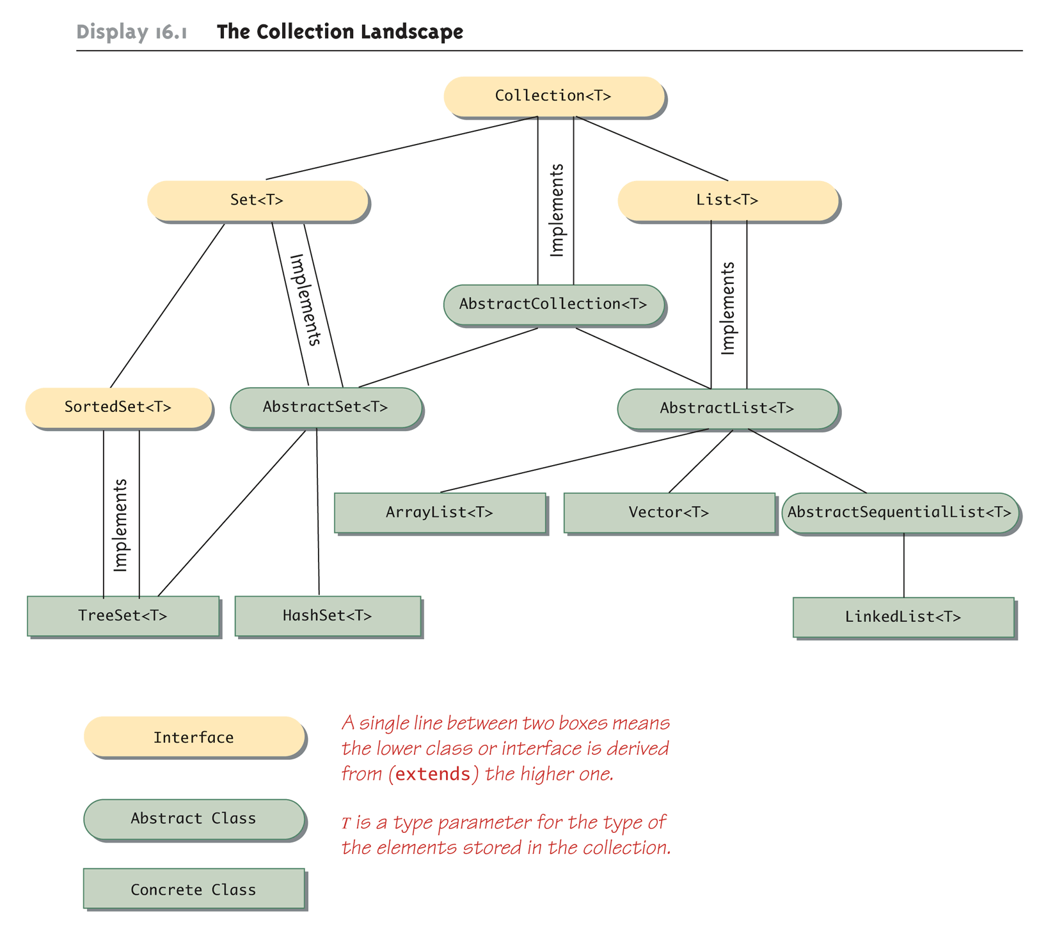
The Collection Landscape

Slide 18
Collection Interface
https://docs.oracle.com/javase/8/docs/api/java/util/Collection.html

Slide 19
List Interface
https://docs.oracle.com/javase/8/docs/api/java/util/List.html

Slide 20
Lists
The List interface extends the Collection interface and represents an ordered collection of elements.
A list can contain duplicate elements and can insert and retrieve elements by a given index position in the list.

Slide 21
Collection Relationships
Classes that implement the List<T> interface have their elements ordered as on a list
Elements are indexed starting with zero
A class that implements the List<T> interface allows elements to occur more than once
The List<T> interface has more method headings than the Collection<T> interface
Some of the methods inherited from the Collection<T> interface have different semantics in the List<T> interface
The ArrayList<T> class implements the List<T> interface

Slide 22
The ArrayList Class
ArrayList is a class in the standard Java libraries
Unlike arrays, which have a fixed length once they have been created, an ArrayList is an object that can grow and shrink while your program is running
In general, an ArrayList serves the same purpose as an array, except that an ArrayList can change length while the program is running

Slide 23
ArrayList Demo

Slide 24
The ArrayList Class
The class ArrayList is implemented using an array as a private instance variable
When this hidden array is full, a new larger hidden array is created and the data is transferred to this new array

Slide 25
The ArrayList Class
Why not always use an ArrayList instead of an array?
An ArrayList is less efficient than an array
It does not have the convenient square bracket notation
The base type of an ArrayList must be a class type (or other reference type): it cannot be a primitive type
This last point is less of a problem now that Java provides automatic boxing and unboxing of primitives

Slide 26
Using the ArrayList Class
In order to make use of the ArrayList class, it must first be imported from the package java.util
An ArrayList is created and named in the same way as object of any class, except that you specify the base type as follows:
ArrayList<BaseType> aList =
new ArrayList<BaseType>();

Slide 27
Parameterized Classes and Generics
The class ArrayList is a parameterized class
It has a parameter, denoted by Base_Type, that can be replaced by any reference type to obtain a class for ArrayLists with the specified base type
Starting with version 5.0, Java allows class definitions with parameters for types
These classes that have type parameters are called parameterized class or generic definitions, or, simply, generics

Slide 28
Nonparameterized ArrayList and Vector Classes
The ArrayList and Vector classes discussed here have a type parameter for the base type
There are also ArrayList and Vector classes with no parameter whose base type is Object
These classes are left over from earlier versions of Java

Slide 29
Generics
Classes and methods can have a type parameter
A type parameter can have any reference type (i.e., any class type) plugged in for the type parameter
When a specific type is plugged in, this produces a specific class type or method
Traditionally, a single uppercase letter is used for a type parameter, but any non-keyword identifier may be used

Slide 30
Generics
A class definition with a type parameter is stored in a file and compiled just like any other class
Once a parameterized class is compiled, it can be used like any other class
However, the class type plugged in for the type parameter must be specified before it can be used in a program
Doing this is said to instantiate the generic class
Sample<String> object =
new Sample<String>();

Slide 31
Using the ArrayList Class
An initial capacity can be specified when creating an ArrayList as well
The following code creates an ArrayList that stores objects of the base type String with an initial capacity of 20 items
ArrayList<String> list =
new ArrayList<String>(20);
Specifying an initial capacity does not limit the size to which an ArrayList can eventually grow
Note that the base type of an ArrayList is specified as a type parameter

Slide 32
Using the ArrayList Class
The add method is used to set an element for the first time in an ArrayList
list.add("something");
The method name add is overloaded
There is also a two argument version that allows an item to be added at any currently used index position or at the first unused position

Slide 33
Using the ArrayList Class
The size method is used to find out how many indices already have elements in the ArrayList
int howMany = list.size();
The set method is used to replace any existing element, and the get method is used to access the value of any existing element
list.set(index, "something else");
String thing = list.get(index);

Slide 34
Tip: Summary of Adding to an ArrayList
The add method is usually used to place an element in an ArrayList position for the first time (at an ArrayList index)
The simplest add method has a single parameter for the element to be added, and adds an element at the next unused index, in order

Slide 35
Tip: Summary of Adding to an ArrayList
An element can be added at an already occupied list position by using the two-parameter version of add
This causes the new element to be placed at the index specified, and every other member of the ArrayList to be moved up by one position

Slide 36
Why are Some Parameters of Type Base_Type and Others of type Object
When looking at the methods available in the ArrayList class, there appears to be some inconsistency
In some cases, when a parameter is naturally an object of the base type, the parameter type is the base type
However, in other cases, it is the type Object
This is because the ArrayList class implements a number of interfaces, and inherits methods from various ancestor classes
These interfaces and ancestor classes specify that certain parameters have type Object

Slide 37
The "For Each" Loop
The ArrayList class is an example of a collection class
Starting with version 5.0, Java has added a new kind of for loop called a for-each or enhanced for loop
This kind of loop has been designed to cycle through all the elements in a collection (like an ArrayList)

Slide 38
Tip: Summary of Adding to an ArrayList
The two-argument version of add can also be used to add an element at the first unused position (if that position is known)
Any individual element can be changed using the set method
However, set can only reset an element at an index that already contains an element
In addition, the method size can be used to determine how many elements are stored in an ArrayList

Slide 39
Methods in the Class ArrayList
The tools for manipulating arrays consist only of the square brackets and the instance variable length
ArrayLists, however, come with a selection of powerful methods that can do many of the things for which code would have to be written in order to do them using arrays

Slide 40
Tip: Use trimToSize to Save Memory
An ArrayList automatically increases its capacity when needed
However, the capacity may increase beyond what a program requires
In addition, although an ArrayList grows automatically when needed, it does not shrink automatically
If an ArrayList has a large amount of excess capacity, an invocation of the method trimToSize will shrink the capacity of the ArrayList down to the size needed

Slide 41
Pitfall: The clone method Makes a Shallow Copy
When a deep copy of an ArrayList is needed, using the clone method is not sufficient
Invoking clone on an ArrayList object produces a shallow copy, not a deep copy
In order to make a deep copy, it must be possible to make a deep copy of objects of the base type
Then a deep copy of each element in the ArrayList can be created and placed into a new ArrayList object

Slide 42
The Vector Class
The Java standard libraries have a class named Vector that behaves almost exactly the same as the class ArrayList
In most situations, either class could be used
However the ArrayList class is newer, and is becoming the preferred class

Slide 43
Sets
The set data structure is used to represent a collection of values without any duplicate elements.
The Set interface extends the Collection interface.

Slide 44
Set Interface
https://docs.oracle.com/javase/8/docs/api/java/util/Set.html

Slide 45
Collection Relationships
Classes that implement the Set<T> interface do not allow an element in the class to occur more than once
The Set<T> interface has the same method headings as the Collection<T> interface, but in some cases the semantics (intended meanings) are different
Methods that are optional in the Collection<T> interface are required in the Set<T> interface

Slide 46
Pitfall: Optional Operations
When an interface lists a method as "optional," it must still be implemented in a class that implements the interface
The optional part means that it is permitted to write a method that does not completely implement its intended semantics
However, if a trivial implementation is given, then the method body should throw an UnsupportedOperationException

Slide 47
Tip: Dealing with All Those Exceptions
The tables of methods for the various collection interfaces and classes indicate that certain exceptions are thrown
These are unchecked exceptions, so they are useful for debugging, but need not be declared or caught
In an existing collection class, they can be viewed as run-time error messages
In a derived class of some other collection class, most or all of them will be inherited
In a collection class defined from scratch, if it is to implement a collection interface, then it should throw the exceptions that are specified in the interface

Slide 48
Concrete Collections Classes
The concrete class HashSet<T> implements the Set<T> interface, and can be used if additional methods are not needed
The HashSet<T> class implements all the methods in the Set<T> interface, and adds only constructors
The HashSet<T> class is implemented using a hash table
The ArrayList<T> and Vector<T> classes implement the List<T> interface, and can be used if additional methods are not needed
Both the ArrayList<T> and Vector<T> interfaces implement all the methods in the interface List<T>
Either class can be used when a List<T> with efficient random access to elements is needed

Slide 49
Concrete Collections Classes
The concrete class LinkedList<T> is a concrete derived class of the abstract class AbstractSequentialList<T>
When efficient sequential movement through a list is needed, the LinkedList<T> class should be used
The interface SortedSet<T> and the concrete class TreeSet<T> are designed for implementations of the Set<T> interface that provide for rapid retrieval of elements
The implementation of the class is similar to a binary tree, but with ways to do inserting that keep the tree balanced

Slide 50
HashSet, TreeSet, LinkedHashSet Demo

Slide 51
Using HashSet with your own Class
If you intend to use the HashSet<T> class with your own class as the parameterized type T , then your class must override the following methods:
public int hashCode();
Ideally returns a unique integer for this object
public boolean equals(Object obj);
Indicates whether or not the reference object is the same as the parameter obj

Slide 52
Maps
The map data structure is used to associate values with unique keys.
Only one value may be associated with any given key.
Given a particular key, the map structure provides a quick access to the associated value.

Slide 53
The Map Framework
The Java map framework deals with collections of ordered pairs
For example, a key and an associated value
Objects in the map framework can implement mathematical functions and relations, so can be used to construct database classes
The map framework uses the Map<T> interface, the AbstractMap<T> class, and classes derived from the AbstractMap<T> class

Slide 54
The Map Landscape

Slide 55
Concrete Map Classes
Normally you will use an instance of a Concrete Map Class
Here we discuss the HashMap<K,V> Class
Internally, the class uses a hash table similar to what was discussed in Chapter 15.
No guarantee as to the order of elements placed in the map.
If you require order then you should use the TreeMap<K,V> class or the LinkedHashMap<K,V> class

Slide 56
HashMap Class
https://docs.oracle.com/javase/8/docs/api/java/util/HashMap.html

Slide 57
Map and HashMap Demo

Slide 58
HashMap<K,V> Class
The initial capacity specifies how many “buckets” exist in the hash table.
This would be analogous to the size of the array of the hash table covered in Chapter 15.
A larger initial capacity results in faster performance but uses more memory
The load factor is a number between 0 and 1.
This variable specifies a percentage such that if the number of elements added to the hash table exceeds the load factor then the capacity of the hash table is automatically increased.
The default load factor is 0.75 and the default initial capacity is 16

Slide 59
Using HashMap with your own Class
Just like the HashSet class, If you intend to use the HashMap<K,V> class with your own class as the parameterized type K , then your class must override the following methods:
public int hashCode();
Ideally returns a unique integer for this object
public boolean equals(Object obj);
Indicates whether or not the reference object is the same as the parameter obj

Slide 60
Iterators
An iterator is an object that is used with a collection to provide sequential access to the collection elements
This access allows examination and possible modification of the elements
An iterator imposes an ordering on the elements of a collection even if the collection itself does not impose any order on the elements it contains
If the collection does impose an ordering on its elements, then the iterator will use the same ordering

Slide 61
Iterator
https://docs.oracle.com/javase/8/docs/api/java/util/Iterator.html

Slide 62
The Iterator<T> Interface
Java provides an Iterator<T> interface
Any object of any class that satisfies the Iterator<T> interface is an Iterator<T>
An Iterator<T> does not stand on its own
It must be associated with some collection object using the method iterator
If c is an instance of a collection class (e.g., HashSet<String>), the following obtains an iterator for c:
Iterator iteratorForC = c.iterator();

Slide 63
Iterator Demo

Slide 64
Using an Iterator with a HashSet<T> Object
A HashSet<T> object imposes no order on the elements it contains
However, an iterator will impose an order on the elements in the hash set
That is, the order in which they are produced by next()
Although the order of the elements so produced may be duplicated for each program run, there is no requirement that this must be the case

Slide 65
Tip: For-Each Loops as Iterators
Although it is not an iterator, a for-each loop can serve the same purpose as an iterator
A for-each loop can be used to cycle through each element in a collection
For-each loops can be used with any of the collections discussed here

Slide 66
The ListIterator<T> Interface
The ListIterator<T> interface extends the Iterator<T> interface, and is designed to work with collections that satisfy the List<T> interface
A ListIterator<T> has all the methods that an Iterator<T> has, plus additional methods
A ListIterator<T> can move in either direction along a list of elements
A ListIterator<T> has methods, such as set and add, that can be used to modify elements

Slide 67
ListIterator Demo

Slide 68
The ListIterator<T> Cursor
Every ListIterator<T> has a position marker known as the cursor
If the list has n elements, they are numbered by indices 0 through n-1, but there are n+1 cursor positions
When next() is invoked, the element immediately following the cursor position is returned and the cursor is moved forward one cursor position
When previous() is invoked, the element immediately before the cursor position is returned and the cursor is moved back one cursor position

Slide 69
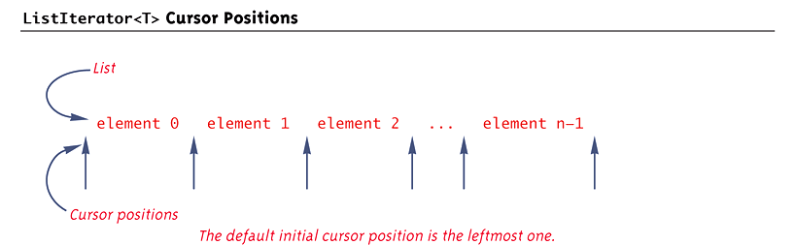
ListIterator<T> Cursor Positions

Slide 70
Pitfall: next and previous Can Return a Reference
Theoretically, when an iterator operation returns an element of the collection, it might return a copy or clone of the element, or it might return a reference to the element
Iterators for the standard predefined collection classes, such as ArrayList<T> and HashSet<T>, actually return references
Therefore, modifying the returned value will modify the element in the collection

Slide 71
Tip: Defining Your Own Iterator Classes
There is usually little need for a programmer defined Iterator<T> or ListIterator<T> class
The easiest and most common way to define a collection class is to make it a derived class of one of the library collection classes
By doing this, the iterator() and listIterator() methods automatically become available to the program
If a collection class must be defined in some other way, then an iterator class should be defined as an inner class of the collection class

